Slide 1
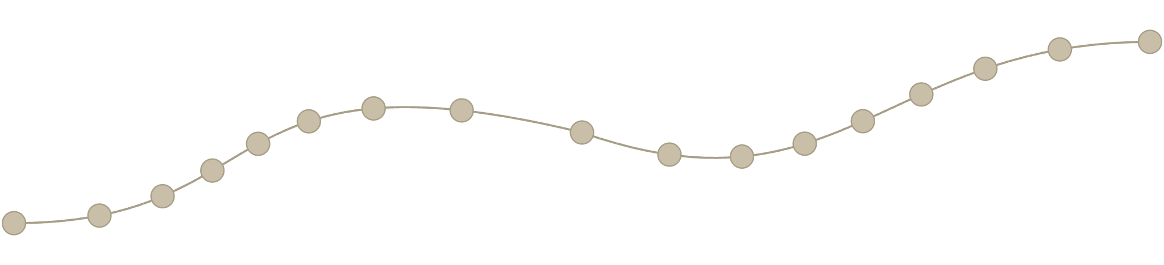

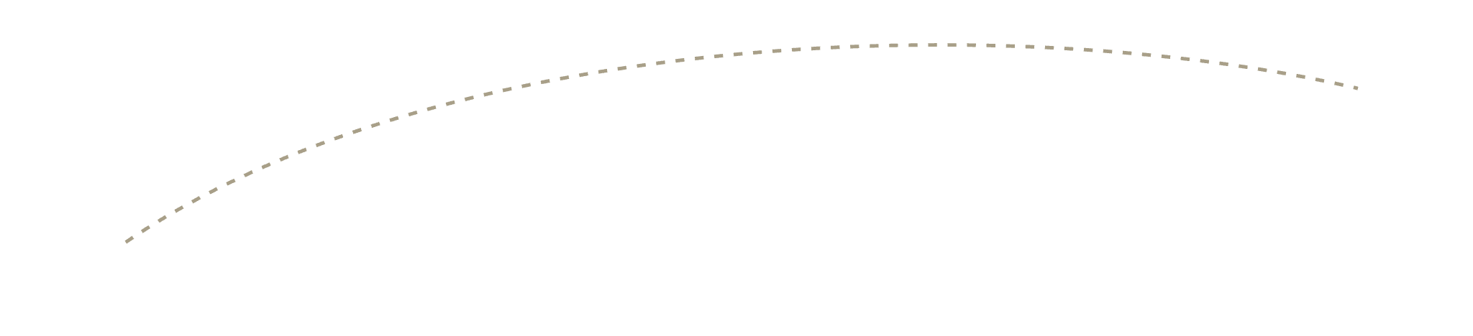
THE PROBLEM
A gene only responds to the enhancers it physically touches in 3D — not the ones nearest on the map
Disease gene
Convergent CTCF sites block the loop
Gene stays OFF
Enhancer
3D genome folding — not DNA sequence — decides which enhancer reaches which gene
Notes:
The problem: which enhancer a gene can hear depends on 3D folding, not just genomic distance. The tangled grey fiber is chromatin itself — DNA wound around histones (nucleosomes) — and the arrows mark a pair of convergent CTCF binding sites, the "stop signs" that halt cohesin loop extrusion and define this TAD boundary. Because the enhancer sits on the far side of that boundary, it never reaches the gene, so the gene stays off.

Slide 2
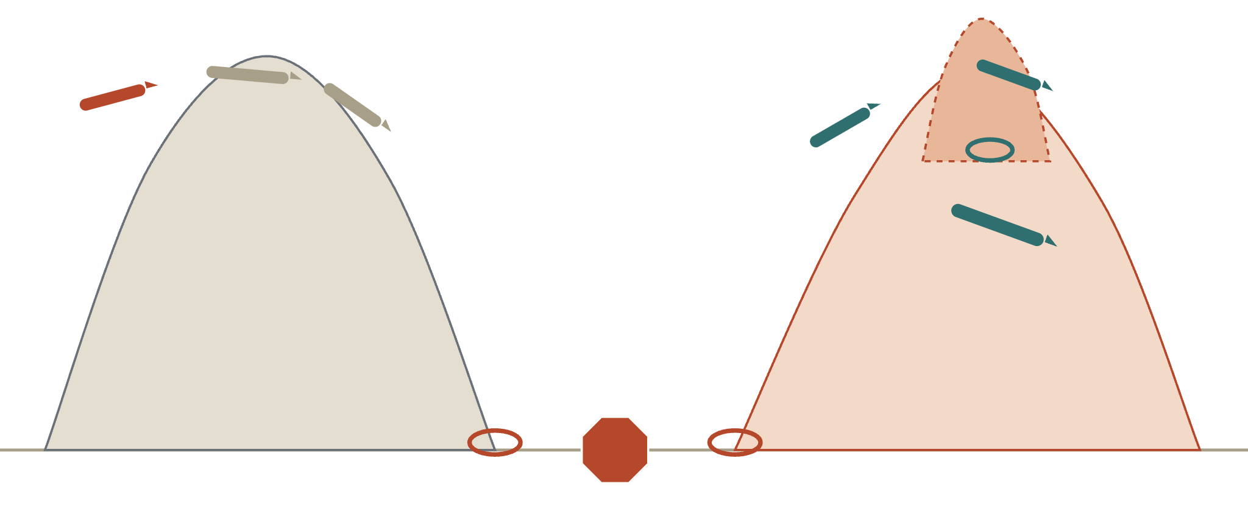
BACKGROUND
TADs are loops that stop at a boundary — and boundaries are enforceable
Sub-TAD
Mediator / cohesin forms the sub-loop
Inactive TAD
Active TAD
Boundary
STOP
Polycomb complex holds this gene silent
CTCF / cohesin: convergent sites anchor the loop
Same convergent-CTCF logic that separates these TADs is what our staple has to cross to make a new loop
Notes:
Background: chromatin is organised into TADs — self-interacting loops formed by cohesin extruding DNA until it hits a pair of convergent CTCF sites, which act as a "stop sign" for loop extrusion (right). An inactive TAD (left) can carry a poised gene held silent by Polycomb; an active TAD (right) carries actively transcribed genes and can itself contain a nested sub-TAD, a smaller loop formed by Mediator/cohesin that brings an enhancer and promoter together within the larger domain. The boundary between TADs is not a fixed wall — it is enforced by specific, addressable protein components (CTCF, cohesin), which is exactly what our engineered staple has to either work around or cross to link two loci that the cell currently keeps apart.

Slide 3





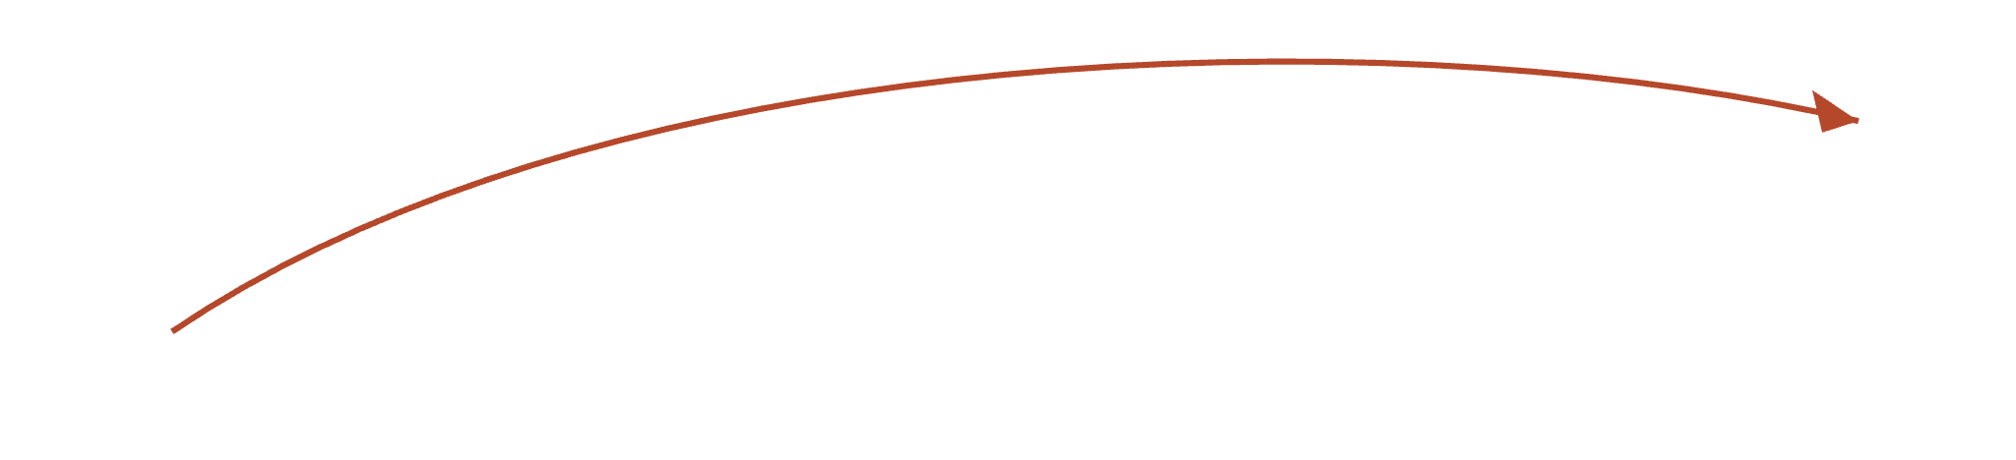
METHOD
Reversible modulation of gene expression without altering sequence.
Sequence + Hi-C data
Classifier predicts E-P probabilities from sequence
dCas staple forces the loop
Drug switch makes it reversible
Disease gene
The engineered loop bridges the CTCF boundary
Gene switches ON
Enhancer
Notes:
The method: score every candidate enhancer by predicted benefit to the target gene minus predicted disruption to its neighbours, then use a programmable dCas staple to force the winning loop across the CTCF boundary that was previously blocking it. A drug-inducible switch on the staple makes the loop, and the expression change, reversible on demand.

Slide 4

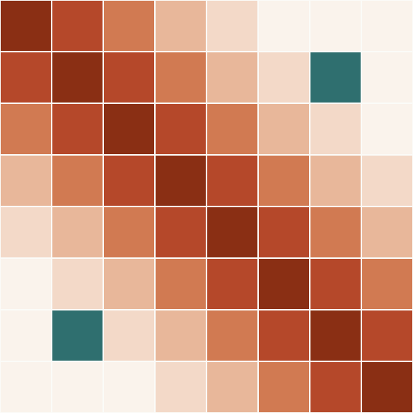







THE PREDICTION MODEL
From sequence and Hi-C to genome-wide target discovery
Predicted contact map
Target discovery: the scoring loop
Predict contact probability: reference vs. edited sequence
Score locus: benefit − disruption
DNA sequence
(~1–2 Mb window)
Sequence-to-contact model
dilated CNN (Akita / AkitaV2 / Orca)
Advance to next candidate locus
Rank all candidate loci by score
Diagonal = nearby DNA in frequent contact; teal cell = a predicted long-range loop
Score = ΔP(enhancer↔gene | edit) − ΣΔP(off-target contacts)
Hi-C / Micro-C data
(ground truth for training & validation)
Highest-benefit, lowest-disruption loci rank first — the model runs once per locus, genome-wide.
Notes:
The prediction step: a convolutional model trained on real Hi-C or Micro-C contact maps learns to predict a genome's 3D contact probabilities directly from its DNA sequence. The scoring loop on the right shows how that turns into target discovery: for each candidate locus, predict how the sequence edit changes contact probability versus the reference, score the change as benefit (gain to the target gene) minus disruption (unwanted changes elsewhere), rank all candidate loci by that score, then advance to the next locus — repeating this loop genome-wide turns a single-locus prediction into a ranked target list.

Slide 5
MODULATORS
Stapling strategies.
dCas9 / dCas12a molecular staples
Zinc finger – Ldb1 tethering
Engineered LDB1 networks
Paired catalytically-dead Cas proteins, each guided by its own sgRNA and fused to interacting peptide domains, pull two loci together (PICasSO, CLOuD9).
A programmable zinc-finger DNA-binding domain fused to the natural looping factor Ldb1, forcing contact at an endogenous gene (Deng et al. 2012).
LDB1 self-associates to link multiple enhancers to a promoter, independently of CTCF and cohesin (Aboreden et al. 2024).
Reversible
Reversible
Reversible
CRISPR-GO
LADL (light-activated looping)
Nuclease-induced translocation
dCas9 pairs plus a chemically-inducible dimerizer bring one locus into contact with another locus or a nuclear body (Wang et al. 2018).
Blue-light-induced CRY2–CIBN dimerization recruits an architectural protein to force a loop on demand (Kim et al. 2019).
ZFNs, TALENs or Cas9 cut both loci; NHEJ repair physically fuses them into one chromosome (Piganeau et al. 2013).
Reversible — drug on/off
Reversible — light on/off
Permanent — models disease translocations
Notes:
Six mechanistically distinct ways to force two genomic loci into 3D contact, from CRISPR-based stapling to a permanent, nuclease-driven fusion used to model cancer translocations. The reversible ones are the realistic candidates for a drug-controlled genome-engineering tool.

Slide 6




REVERSIBILITY
Reversibility strategies.
Chemically-induced dimerization
Optogenetics (LADL, CRY2–CIBN)
Rapamycin (FKBP–FRB), abscisic acid (PYL–ABI) or gibberellin (GID1–GAI): add the small molecule to form the staple, wash it out and the loop dissolves within hours.
Blue light drives the staple together; the loop decays within minutes once the light is off — the fastest and most tunable switch of the four (Kim et al. 2019).
Auxin-inducible degron (AID)
Orthogonal chemical inducers
Degrade the loop-anchoring factor itself (e.g. CTCF) on demand; the loop collapses, then re-forms once the protein is restored (Kubo et al. 2021).
Agrochemical dimerizers such as mandipropamid give a low-toxicity, non-rapamycin switch — useful when a project already uses FKBP–FRB elsewhere (Yu et al. 2021).
Speed vs. control: light is fastest to reverse, degrons are the most surgical, chemistry is the easiest to deploy
Notes:
Four distinct ways to make a staple reversible: two act on the staple's dimerization directly (a small molecule or light), one removes the anchoring protein rather than the staple, and one is an alternative chemistry for teams already using a rapamycin-based system elsewhere.

